Slide 1
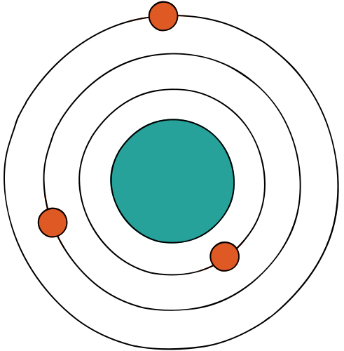
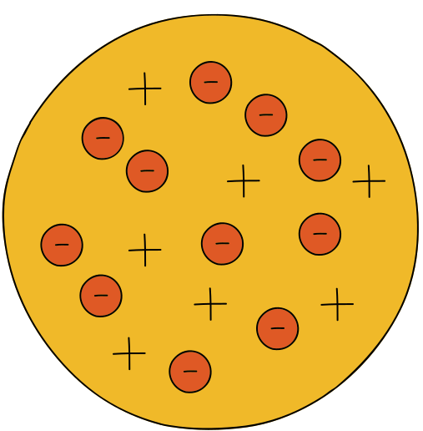



FREE
EDUCATION

Slide 2








Challenges for every nations
It’s hard to get, to keep and hold
but, it also a new chance

Slide 3


ADVANTAGES
1
A wide range of student
New phenomenon
2
Promoting growth economic
3
More educated workfore
4

Slide 4

DISADVANTAGES
THE ENORMOUS COST
HIGHLY COMPETITIVE IN JOB MARKET
OVERCROWDING STUDENT
THE ONUS AMONG STUDENT

Slide 5
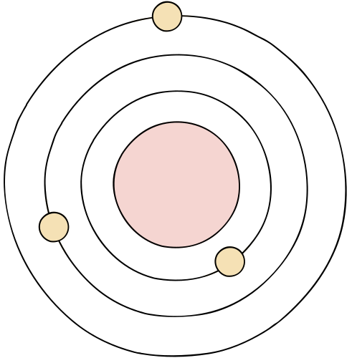


SUMARY
Whether there is free education or not will depend on the status of that country
Each country needs to create the best conditions for students

Slide 6

THANKS
FOR
WATCHING
Trần Thảo Nguyên

